Slide 1
Towards Web-based Delta Synchronization for Cloud Storage Services
He Xiao and Zhenhua Li, Tsinghua University; Ennan Zhai, Yale University;
Tianyin Xu, UIUC; Yang Li and Yunhao Liu, Tsinghua University;
Quanlu Zhang, Microsoft Research Asia; Yao Liu, SUNY Binghamton
xiaoh16@gmail.com
USENIX FAST’18, Feb. 14, 2018
Notes:
Thanks for lots of introduction. Today, my report is Towards Web-based Delta Synchronization for Cloud Storage Services.

Slide 2
Network Traffic is Overwhelming in Cloud Storage
Cloud Traffic has 30% CAGR (Compound Average Growth Rate)
File Synchronization(Sync)
Network Traffic
Client
Cloud Sever
Notes:
Cloud Storage services have a growing popularity in the last few years, it brings a large volume of network traffic overhead to both the client and cloud sides
The main network traffic is caused by file sync between Client and sever.

Slide 3
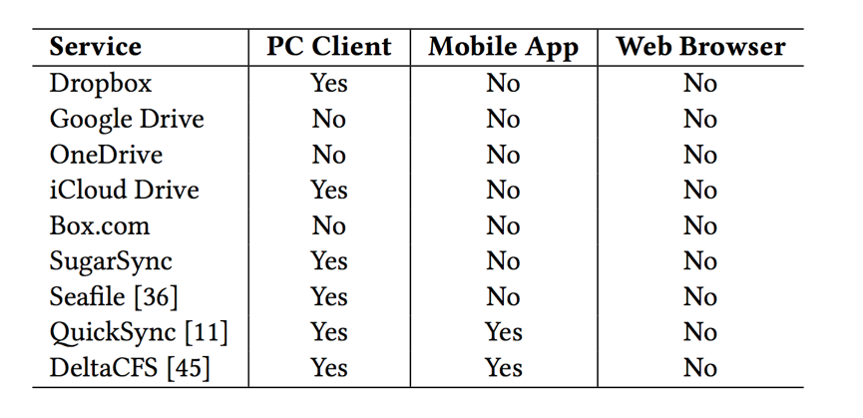
Delta Sync Improves Network Efficiency
10 MB
Full File
Delta sync support in nine state-of-the-art cloud storage services
New File
Old File
Full Sync
10 MB
Delta Data
1 B
New File
Old File
Delta Sync
Delta Sync is crucial for reducing cloud storage network traffic.
Notes:
A lot of efforts have been made to improve cloud storage network-level efficiency. Among them, delta sync is very important because of its fine granularity, it can achieve significant traffic savings in the presence of users’ file edits.
For example, Let’s suppose there is a 10 megabytes file and users are changing just 1 bit, instead of synchronizing the whole file, the delta sync will only sync the changed bits. It provides huge benefits for large files with small change, which is very common in cloud storage. So, we can say delta sync is crucial for reducing network traffic.
Unfortunately, according to our investigations, today delta sync is only available for most PC clients and few mobile apps, but not for the web.

Slide 4
No Web-based Delta Sync
Web-based delta sync is essential for cloud storage web clients and web apps
Web is the most pervasive and OS-independent cloud storage access method
Why web-based delta sync is not supported by today’s commercial cloud storage services ?
Notes:
Web is the most pervasive and OS-independent access method. this gap tremendously affects web users’ experiences in terms of both sync speed and traffic cost.
In this paper, we address ourselves to understand Why web-based delta sync is not supported by commercial cloud storage. and propose our solution.

Slide 5
WebRsync: First Workable Web Delta Sync
Implement rsync on web framework with pure web tech: JavaScript + HTML5 + WebSocket
Points out the Challenges of supporting delta sync on web.
JavaScript Implementation of Rsync
C Implementation
of Rsync
WebSocket
Web Browser
Web Server
JavaScript
HTML5 FileAPI
High-Speed
Internal Network
Local
File System
Storage Backend
Aliyun OSS / OpenStack Swift
Notes:
WebRsync is our first Endeavor. It is the first workable web-based delta sync for cloud storage services.
It is a straight-forward implementation, but it can point out the challenges and opportunities of supporting delta sync under current web browsers.
In our webrsync framework,JavaScript read file binaries from local file system with Html5 FileAPI. On the server side, we use some distributed cloud storage as backend.
On the web browser side, we have to implement rsync with Javascript, on the other hand, we can use more efficient C code on server side.
Client and server communicate with websocket protocol.

Slide 6
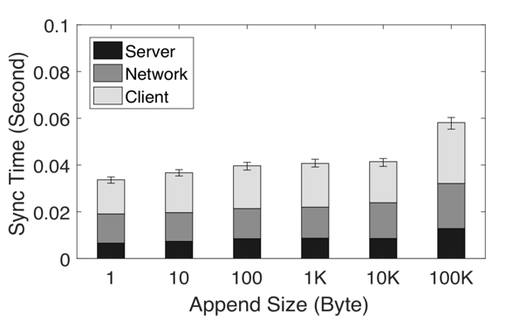
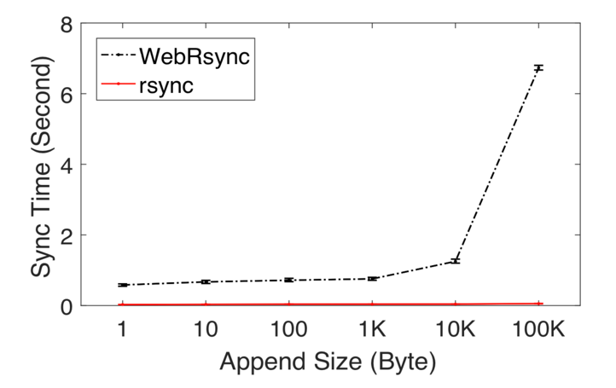
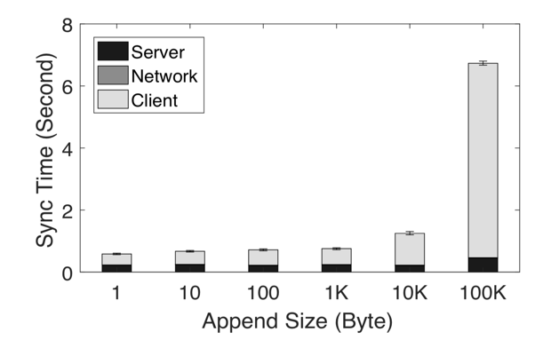
WebRsync benchmarking: poor client performance
~40%
Rsync
60-92%
Sync time of WebRsync vs Linux rsync
14–25 times slower
WebRsync
Notes:
We compare the performance of WebRsync and Linux rsync by operating random append , insert and cut on real files.
The sync time of WebRsync is significantly longer than that of Rsync by 14–25 times.
Furthermore , we decompose the sync time into : client , server and network.
The result indicates that the sync bottleneck of WebRsync is
due to the inefficiency of the web client’s executing JavaScript code.

Slide 7
StagMeter Tool
Timing tasks: Printing timestamps every 100ms:
x x x x x x x x x x x x x x x x x x x x x x x x x x x x x x x x x x x x
Stagnation: single-thread is occupied by some backend tasks
x x x x x x x x x x x x x x x x x x x x x
Stagnation Interval
User’s operation cannot get response timely.
Notes:
WebRsync not only leads to more sync time, but also causes web browsers to frequently stagnate and even hang because of the heavy CPU consumption.
We develop the StagMeter tool to quantitatively understand the stagnation of web browser.
Briefly, stagmeter is a timing tasks who prints timestamps every 100ms in the web, to simulate any possible user actions.
If the single-thread is occupied by some backend tasks, user’s operation cannot get response timely,
The printed timestamps will look like this, and the interval is the range of stagnation.

Slide 8
Measuring Stagnation with StagMeter
1. Send meta data
Wait server
2. Checksum Search
and Comparison
3. Send tokens and literal bytes
High CPU Utilization when computing
Timestamp Printing is suspended
Web is under stagnation state
Sync Process (Second)
Notes:
This figure illustrates the stagnation of WebRsync.
We also record the CPU Utilization of every stages in the sync process.
In stage 2, when the client operate checksum searching and comparison
The CPU utilization is very high and it will cause stagnation.

Slide 9
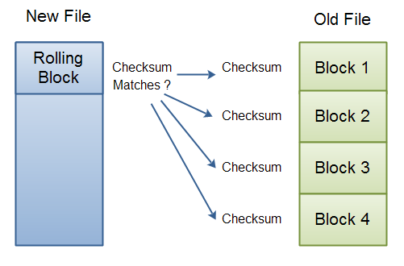
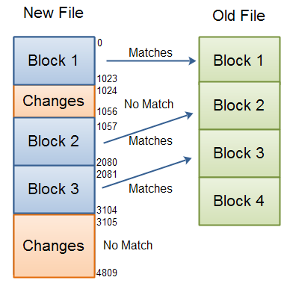
Why poor client : slow searching and comparing
Client
Cloud
Bottleneck
Notes:
Further more, we analyze the detailed steps of Rsync protocols , to find the bottleneck of poor client on webRsync.
According to the Rsync steps, the server segment files and compute checksum block by block.
But the client who has the new file, has to operate a rolling checksum to search and compare the matched blocks byte by byte, Which is much slower than segmentation.
Then ,the client will transmit the matched block id and changed bits to the server.
So the bottleneck of the client is checksum searching and comparing

Slide 10
WebR2sync: Reverse Computation Process
Client
New file
Server
Old file
Segmentation
& fingerprinting
Checksum list
Checksum list
Searching
& Comparing
Matched Tokens
Matched Tokens
Changed Bits
Meta data
Construct New Files
Notes:
Inspired by above observations, We develop a new method called webr2sync to optimize the client performance.
As shown in this Figure , to address the overload issue, WebR2sync reverses the process of WebRsync by moving the computation intensive search and comparison operations to the server side;
The complex operations can be executed more efficient with C code.
This reversing operation works same as original rsync because we can separate matched tokens searching and changed bits generation into two sides.
That is to say, changed bits must be generated on the client side with new file but matched tokens can be operated on server side.

Slide 11
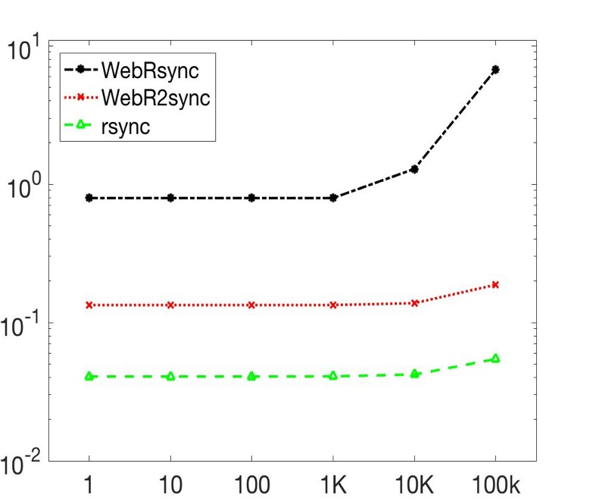
Performance of WebR2sync
Sever side is 2-3 time slower
Sync Time (Second)
Edit Size (Byte)
Issue: Server takes severely heavy overhead.
Notes:
We compare the sync time of the webR2sync and Original WebRync
While WebR2sync significantly cuts the computation burden on the web client, it brings considerable computation overhead to the server side.

Slide 12
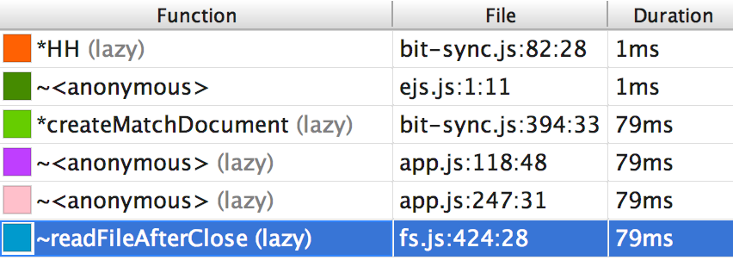
Server-side Overhead Profiling
Checksum searching and block comparison occupy 80% of the computing time
MD5 Computing
Checksum Search
Use faster hash functions to replace MD5
Reduce checksum searching overhead
Notes:
We make a CPU profiling on the server and find that
Checksum searching and block comparison occupy 80% of the computing time
To this end, we make two-fold additional efforts to optimize the server-side computation overhead.

Slide 13
Replacing MD5 with SipHash in Chunk Comparison
A comparison of pseudorandom hash functions
SipHash remain low
Collision Probability
at much faster speed
Notes:
The first optimization is replacing MD5 with faster hash function in checksum comparison.
According to this table, SipHash seeks out a sweet spot between collision probability and overhead.
It remains low Collision Probability at much faster speed. // todo add more

Slide 14
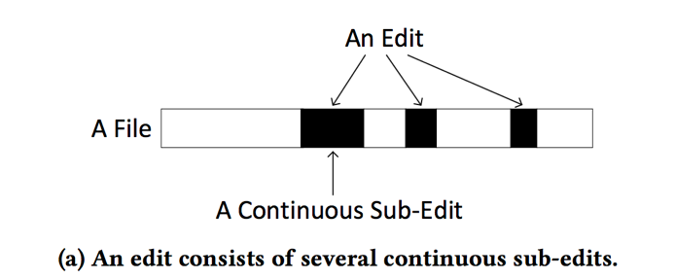
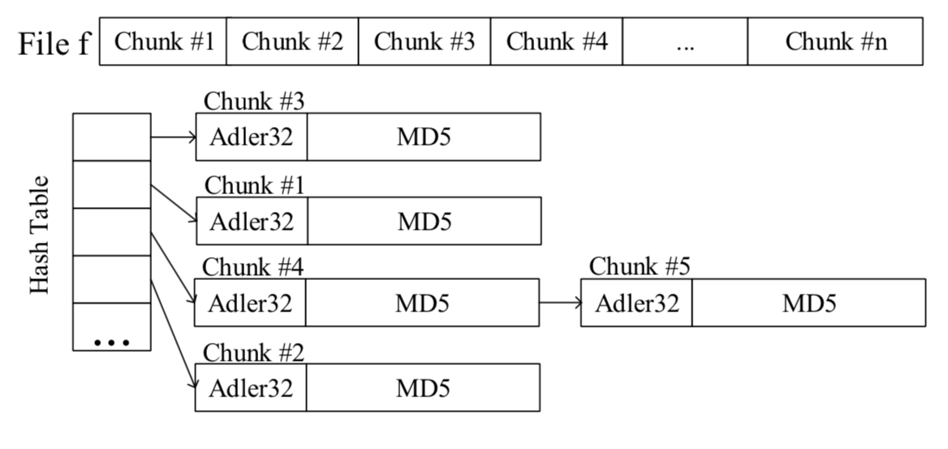
Reduce Checksum Searching by Exploiting Locality of File Edits.
Over 95% modified files have less than 10 edits.
Searching
Checksum
search
Hash Table
Adler32-1
Adler32-2
Adler32-3
Adler32-4
Compare
MD5-1
MD5-2
MD5-3
MD5-4
Block1
Block2
Block3
Block4
Notes:
The second solution is based on the locality of modification, in original WebR2sync, the server operate a three-level searching to find the matched blocks. Weak checksum must be found byte by byte, but under real cases, weak checksum is not necessary because of locality of user edits.
Locality means edits tend to be continuous , and unchanged parts also has a great probability to be adjacent.
In web delta sync, we can exploit the locality of modification, in traditional operation, we search and compare the checksum one by one. But with edit locality , we can jump to comparing next strong checksum without searching in weak checksum.
It saves about 90% of the searching overhead.

Slide 15
A Series of attempts of other techs: Native Extension, Parallelism
Native Extension: leverage the native client for web browsers. -> as quick as native rsync , supported platforms limited (e.g. Mobile web)
WebRsync-Parallel: using HTML5 web workers to avoid stagnations. -> avoid stagnation but not on sync time
The drawback of WebRsync cannot be fundamentally addressed through above optimizations
Notes:
We also do a series of attempts on other techniques according to our reviewers’ advices,
We didn’t use these techniques at first because they are not supported by all web browsers,
But it’s worthy to analyze their performance.
The first one is native extension, it leverages the native client for web browsers, result shows it is as quick as native rsync because it’s written in C module. But it is only supported by the chrome browser.

Slide 16
Evaluation Setup
Basic experiment setup visualized in a map of China
Notes:
We setup an experiment over a real cloud storage system to evaluate those methods.
The webserver and client are in different city.
We randomly edit the files and use these methods to sync from client to server.
Here are the results

Slide 17
Sync Time
WebR2sync+ is 2-3 times faster than WebR2sync
and 15-20 times faster than WebRsync
Notes:
We measure the sync time of all above methods. The sync time of WebR2sync+ is substantially shorter than that of WebR2sync (by 2 to 3 times) and 15 to 20 times than WebRsync. In other words, WebR2sync+ outpaces WebRsync by an order of magnitude; it has comparable performance as PC client-based rsync.

Slide 18
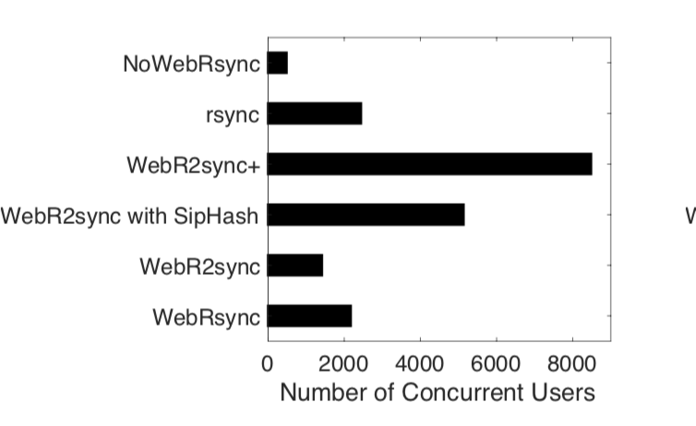
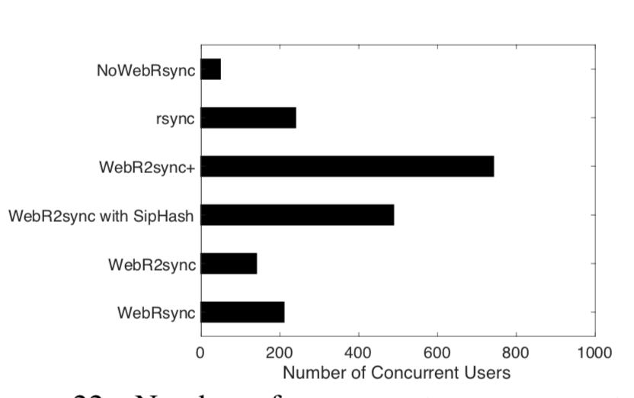
Throughput
Regular Workload
Intensive Workload
This throughput is as 4 times as that of WebR2sync/rsync and as 9 times as that of NoWebRsync.
Notes:
WebR2sync+can simultaneously support 8000 web clients’ delta sync using an ordinary Virtual Machine .
This throughput is as 4 times as that of WebR2sync and better than local native rsync.
And the throughput is 9 times as that of NoWebRsync.

Slide 19
Conclusion
Implement a workable web-based delta sync named WebRsync using JavaScript and Html5, then quantifying the stagnation on browser by StagMeter.
WebR2sync: Reverse the rsync process by moving computation-intensive operations from client with JavaScript to server side with efficient native C code.
WebR2sync+: By exploiting the edit locality and trading off hash algorithms, we make the computation overhead affordable at the server side.
Notes:
To make this solution practical, We made the following three major efforts:
Firstly, we implement a workable web-based delta sync using JavaScript and Html5, then quantifying the web sync time and stagnation.
Then, the webrsync benchmark inspired us to reverse the rsync process to reduce the computation overhead on client side.
To this end, we make two-fold additional efforts to optimize the server-side computation overhead.

Slide 20
Future Work
A seamless way to integrate the server-side design of WebR2sync+ with the back-end of commercial cloud storage vendors (like Dropbox and iCloud Drive).
Explore the benefits of using more fine-grained and complex delta sync protocols, such as CDC and its variants.
We envision to expand the usage of WebR2sync+ for a broader range of web service scenarios.
Notes:
We are investigating the following aspects as the future work.
looking for a seamless
Explore the CDC
Expand to a broader range of scenarios

Slide 21
Q&A
Thanks!

Slide 22
Rsync protocol procedure
Client
New file
Server
Old file
Block1
Adler32
MD5
Block2
Adler32
MD5
Searching &
Comparing
NO
Block3
Adler32
MD5
…
…
…
YES
Segmentation and fingerprinting
1 block matched
1 byte offset
Matched Tokens
Literal Bytes
Tokens and Literal Bytes
Construct New File
Notes:
To address the overload issue, we analyze the detailed procedure of rsync protocol.
When synchronizing a modified file from client to server
In the first step, the server segment the old files and generating fingerprinting of every blocks.
Then, server transmits the fingerprint list to client,
Client execute a much more complexed operations called searching and comparing
If one block match old block fingerprinting, client generate a matched token , otherwise, it generate a single literal byte
Finally, client collected all tokens and literal bytes and transmit them to server
The server uses these meta data to construct a copy of new file.

Slide 23
Conclusion
WebRsync: an intuitive web-based delta sync solution
understand the obstacles to support web-based delta sync
A series of efforts towards a practical solution of web-based delta sync for cloud storage services:
WebRsync-native, WebRsync-parallel, WebRsync+
WebR2sync+: a practical web-based delta sync solution with one client-side optimization called WebR2sync and two-fold server-side optimizations.
Notes:
Let’s conclude this paper work.

Slide 24
Discussion
Probability of collisions of file checksums
Characteristics of file operations in real-world scenarios from the perspective of sync
Locality measure for deciding whether to apply locality-based optimization.
Notes:
Ok, I still have some problems unsolved that I would discuss with you.

Slide 25
WebRsync Detailed Description
Weak Checksum
Search
NO
Block1
Adler32
MD5
Block2
Adler32
MD5
Block3
Adler32
MD5
YES
Strong Checksum Compare
NO
…
…
…
1 byte offset
YES
Rolling Adler32
O(1): Adler(i)=>Adler(i+1)
1 block offset
Matched Tokens
Literal Bytes
Construct New File
Client
Server

Slide 26
Solve Possible Hash Collision
Replace MD5 with SipHash, may cause potential collisions (Probability p), so does MD5.
Our Solution: Use Spooky (fastest method, collision probability p’).
The probability of collisions is p*p’
Alternative: Use MD5 or other strong hash functions as a global verification.
Compute MD5 over whole file is expensive.

Slide 27
WebR2sync: Flowchart and Data structure
Block 1
Block 2
Weak Checksum
Search
NO
Block 3
Block 4
Block 1
Block 2
YES
Block 3
Strong Checksum Compare
NO
Block 4
1 byte offset
No further Operation
YES
When find a match, record the associated index
Construct New Files
Client
Server

Slide 28
Stagnation due to JavaScript’s Single-thread Event Loop Model
StagMeter
//print timestamp every 100ms
setInterval(print(timestamp),100)
//print the timestamp of every keystone( start or end of a task)
on_start(task); print(task.id, timestamp)
on_finish(task); print(task.id, timestamp)
Notes:
JavaScript has a concurrency model based on an "event loop". This model is quite different from models in other languages like C and Java.
JavaScript in browsers doesn‘t run concurrently. It means CPU-intensive task will occupy the even handler,
the page becomes unresponsive until the script is finished. We call it stagnation on the web.
We invent a tool to quantify the stagnation. Firstly, we use a loop timing task to print timestamp, then we call the tested task, if the task occupy the event handler, timestamp will suspend.
We can quantify the duration of stagnation from result.

Slide 29
Sync Time decomposed
WebR2sync+ client takes stable and shorter time.
Because of the Server-side optimization, computing time is
much shorter both in client and server.
Notes:
First, the majority of sync time is spent at the client side for WebRsync, while it is spent for network latency for WebR2sync+. Therefore, the web browser does not stagnate or crash. Second, the server-side sync time is still much shorter than the client-side sync time, which confirms the efficacy of our server-side optimizations.

